Slide 1

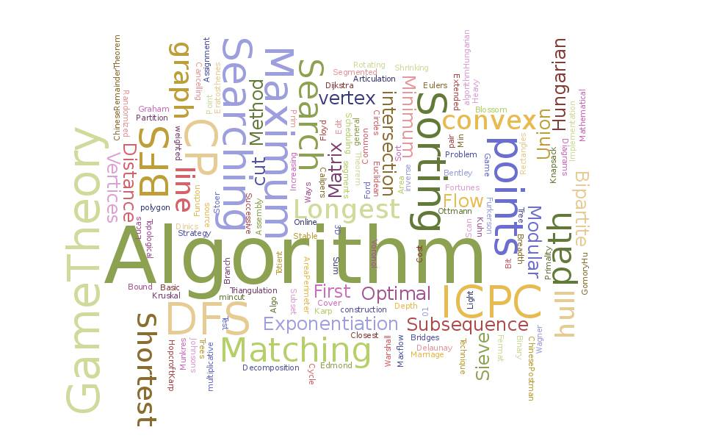
ECE2420
Nate Jensen

Slide 2
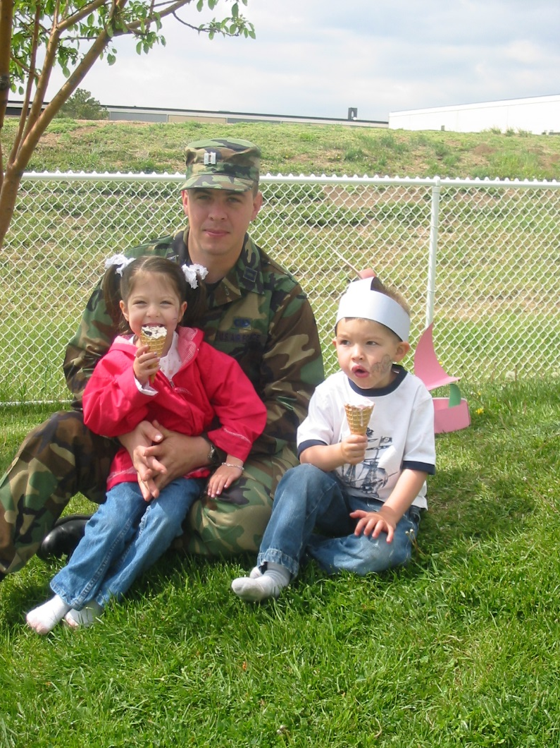
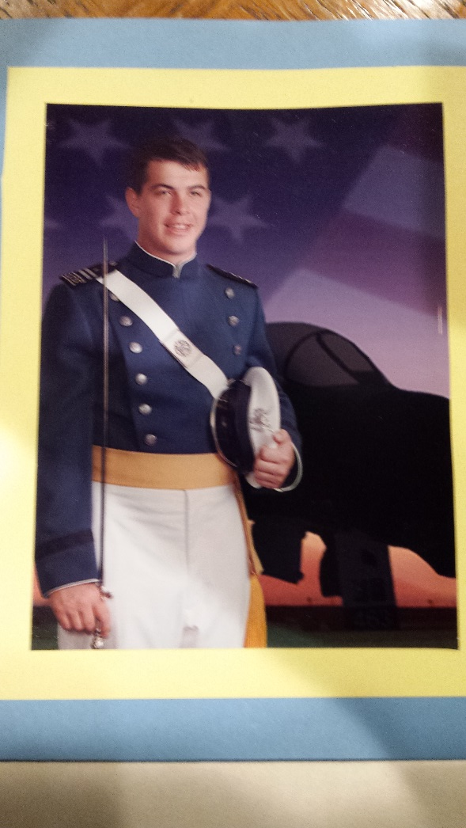
Who Am I
Learned leadership lessons at the sawmill – “What’s more valuable: A man that can do the work of 10 men or a man that can get 10 men to work?”
USAFA was a natural fit
Wanted to fly fighters
Turned down a pilot slot to become a 33S
Top flight commander; graduated on Dean’s list; invited back to instruct
Immediately went to AFIT for MS in CS
Leadership is the art of getting someone else to do something you want done because he wants to do it. – Dwight D. Eisenhower

Slide 3
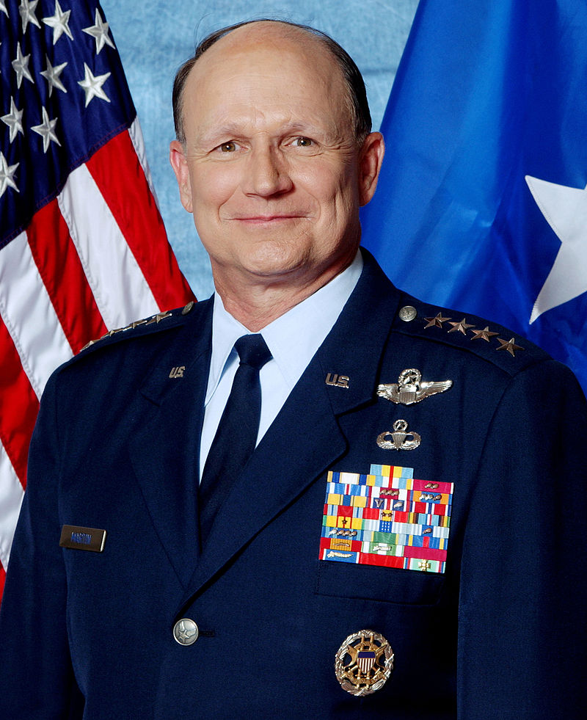
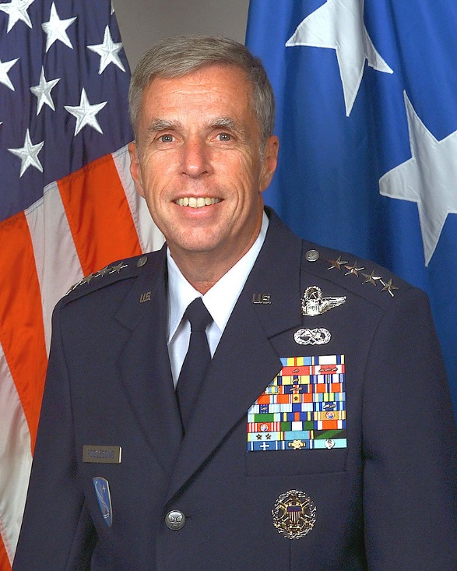
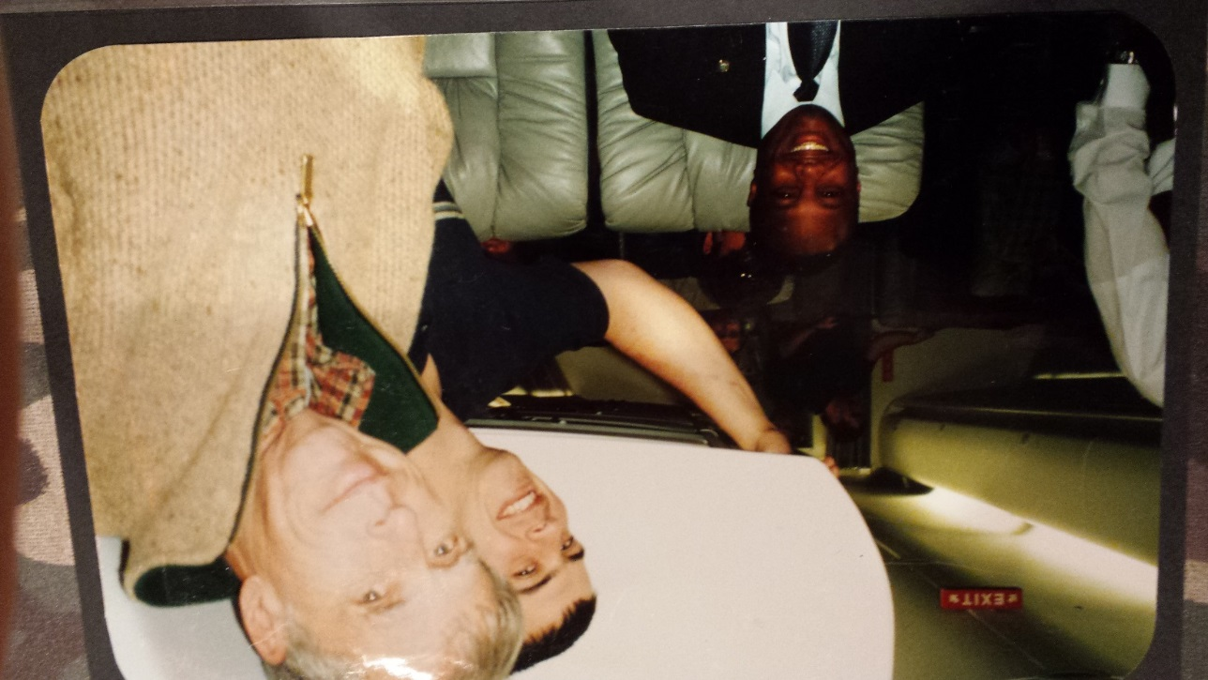
Who Am I
Worked directly for two different 4-Star Generals
Gregory “Speedy” Martin
Robert “Doc” Foglesong
This is not normal for a Lieutenant or Captain
Served as personal communications aide de camp
Set up secure communications
Handled personal e-mail
Direct path from COMUSAFE to USAFE/A6
You manage things, you lead people – Rear Admiral Grace Hopper

Slide 4
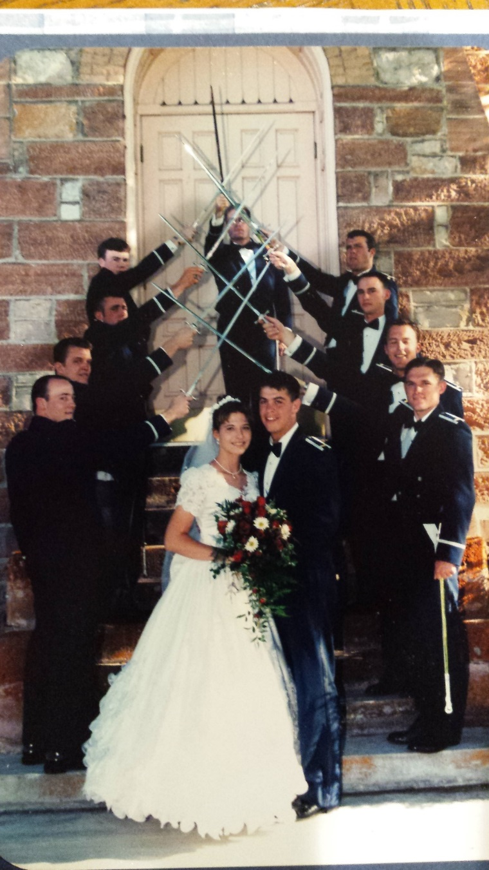

Who Am I
Against both 4-Star’s guidance I went back to USAFA to teach
Taught programming, operating systems, and information warfare
Won junior faculty member of the year – nominated by students, peers, and superiors
Awarded Meritorious Service Medal as a Captain – this is not common
As a senior Captain, it became clear that engineering was a smaller part of my duties
The mediocre teacher tells. The good teacher explains. The superior teacher demonstrates. The great teacher inspires – William Arthur Ward

Slide 5
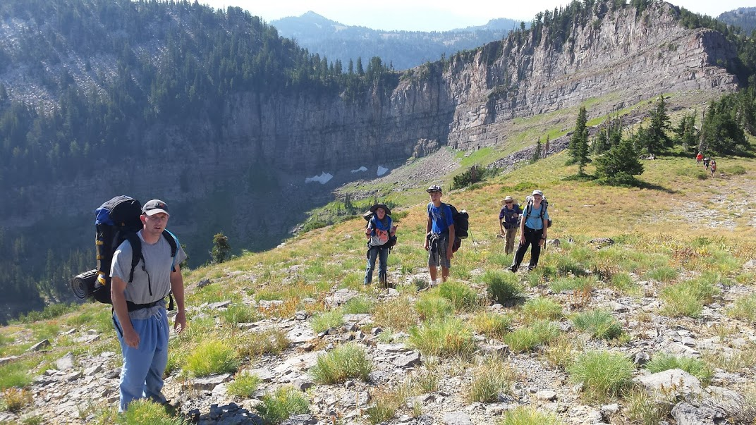
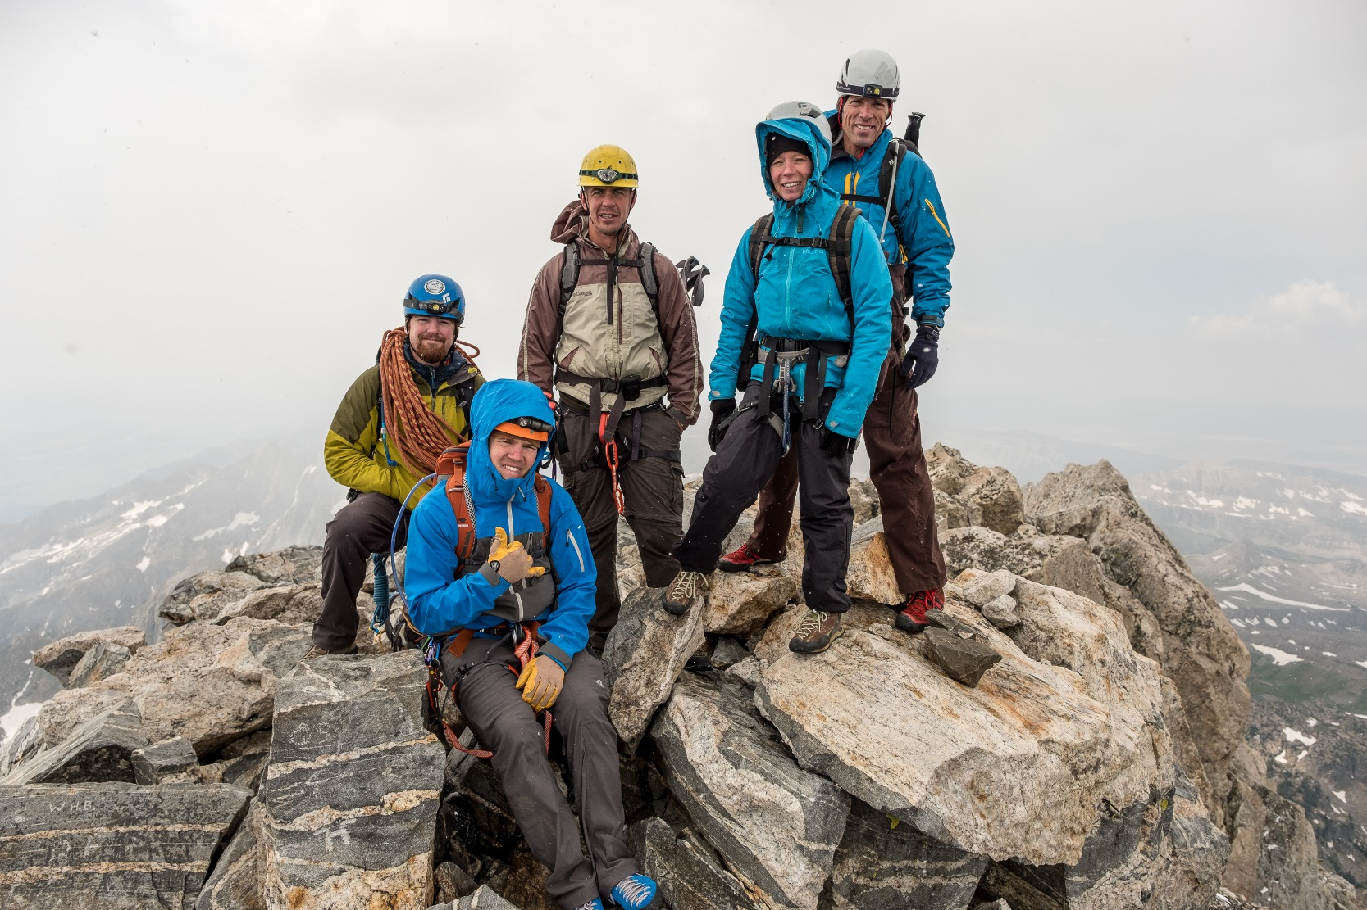

About Me (Personal)

Slide 6
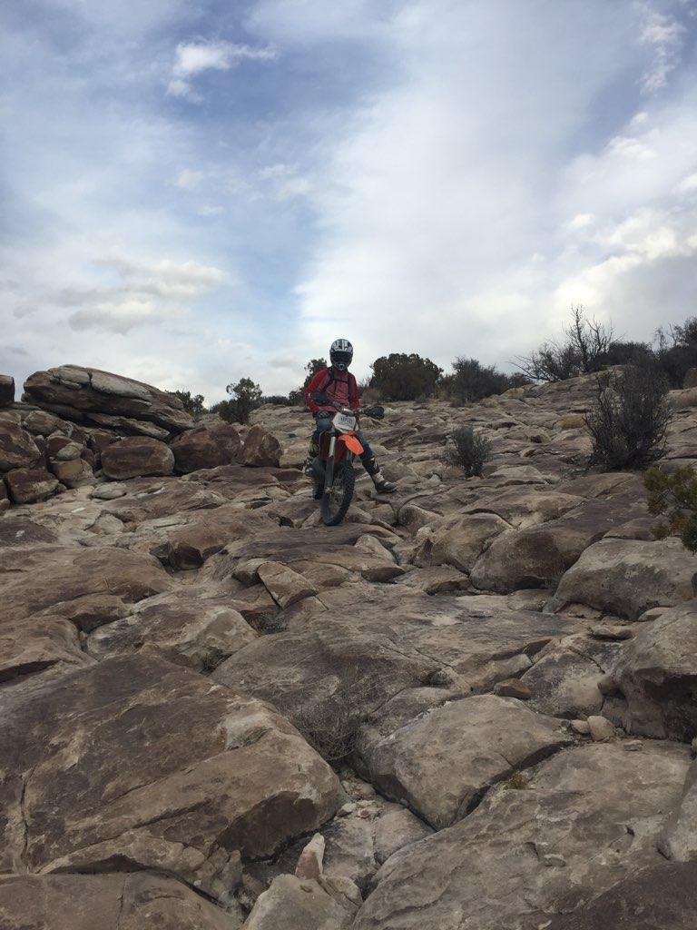
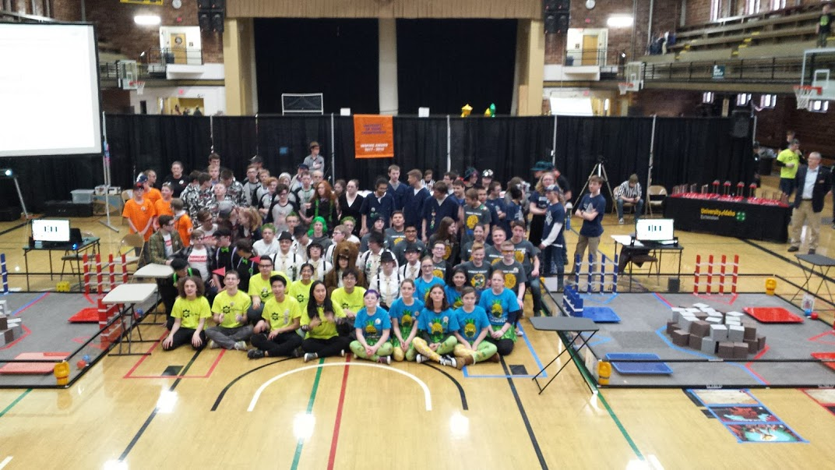
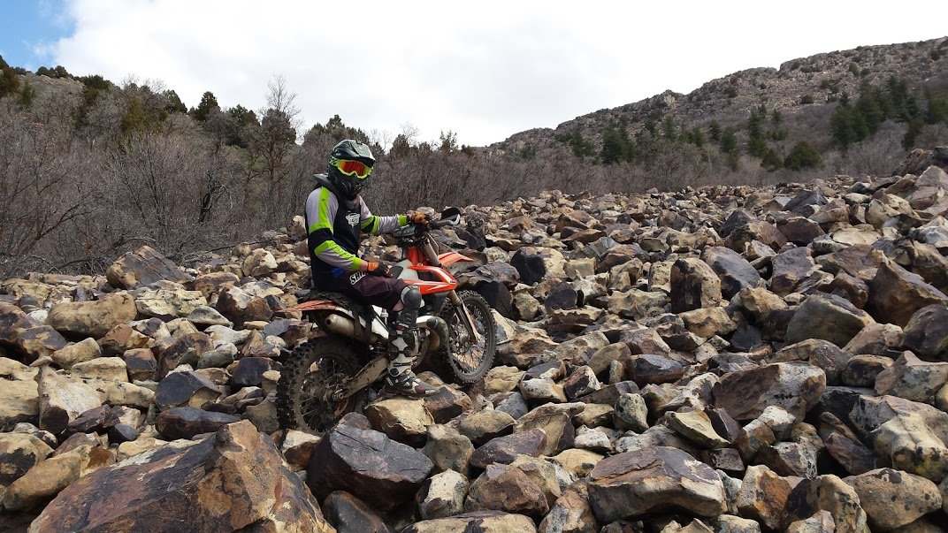
About Me (Personal)

Slide 7
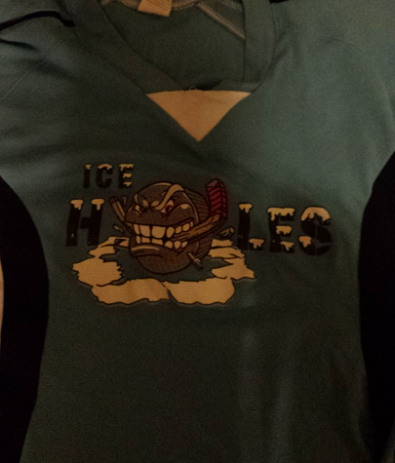
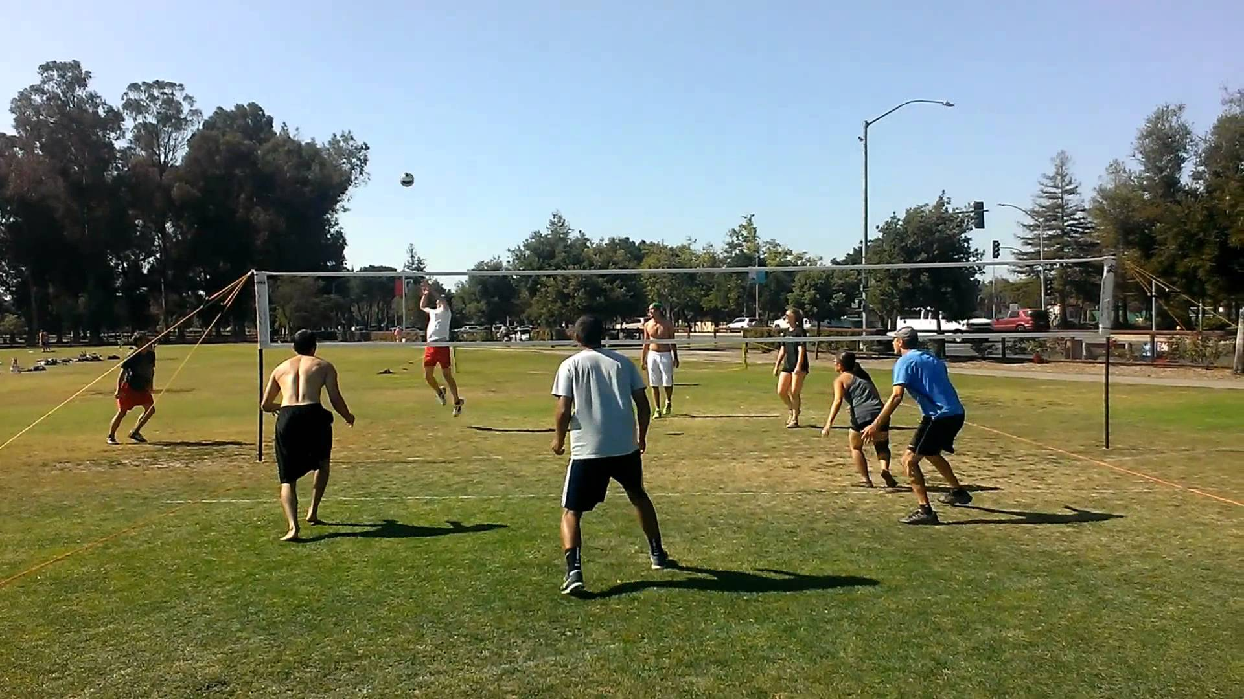
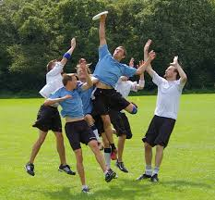
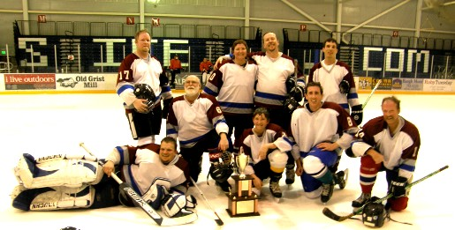
About Me (Personal)

Slide 8
Desired Educational Outcomes
#1: Learn to LOVE coding
#2: Become proficient C++ coders through implementing cool algorithms
I believe you are smarter than me… I’ve just been coding for a long time and love every second of it.
I hope that you do too

Slide 9
Class Policy
I’m going to ask a lot, (at least I think I am), but I’m here to help
Nate.Jensen@sdl.usu.edu
208-540-2733 (cell – text during day is hard)
435-713-3118 (work)
You can contact me anytime for extra instruction
Your time is you most valuable asset; spend it wisely
You need to start programming exercises early

Slide 10
Class Policy
Your integrity is way more important than this class
Don’t get a soft copy of another student’s code
I’d prefer that you don’t look at each other’s code. Probably OK for the helper; no so much for the helpee
We’ll have a mid-term exam and a final project

Slide 11
Your Turn!

