Slide 1
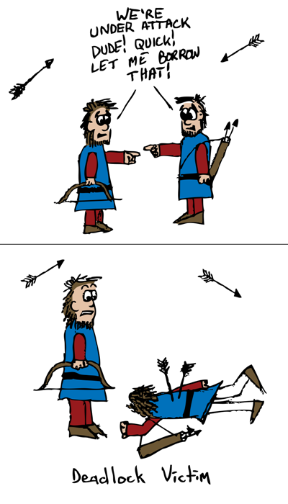
Deadlock

Slide 2
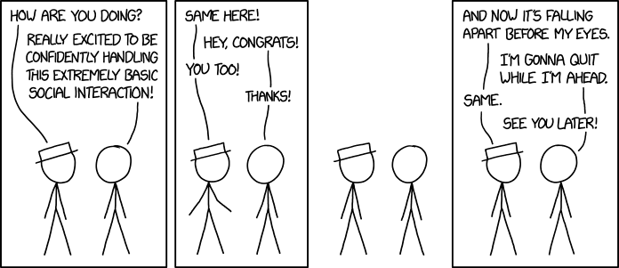
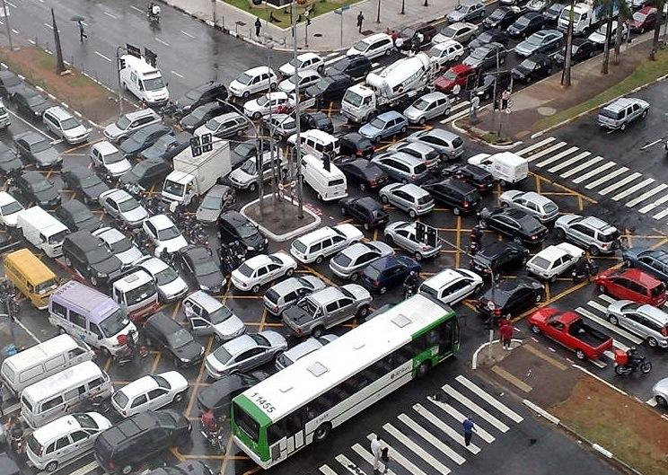
A problem that plagues more than our code

Slide 3
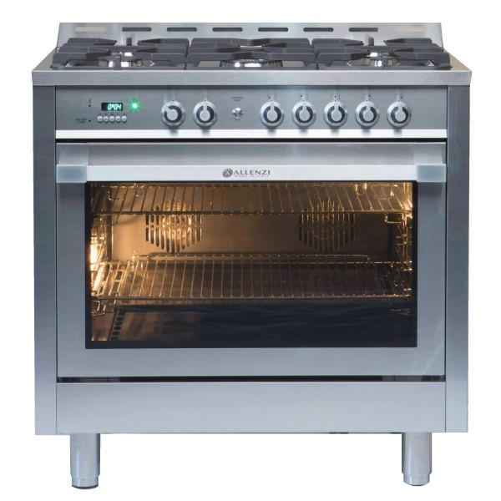
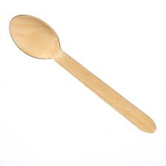
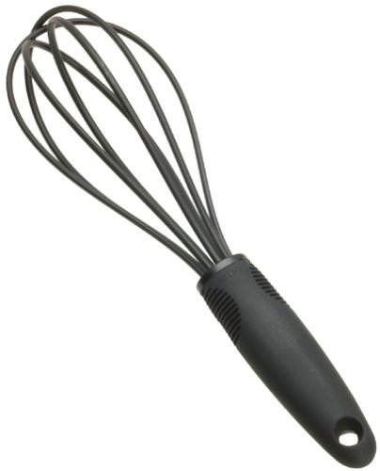
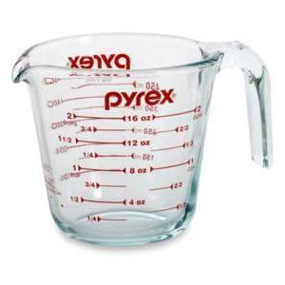
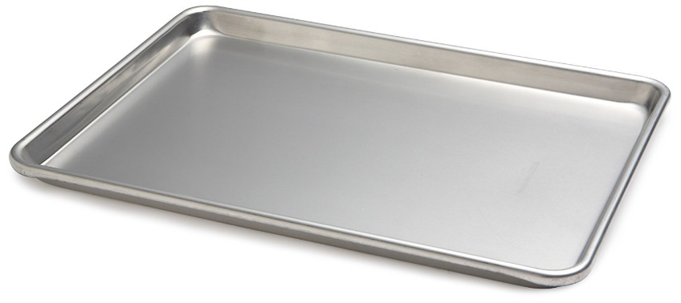
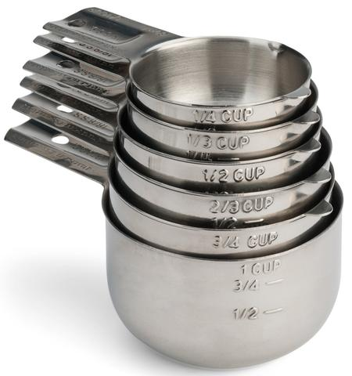
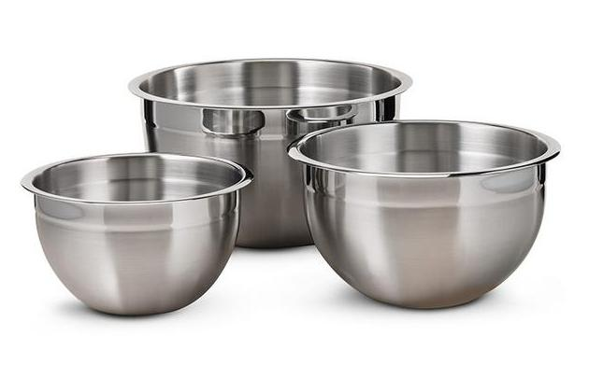
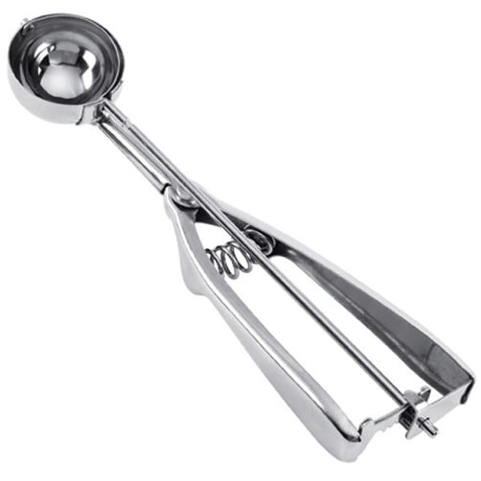
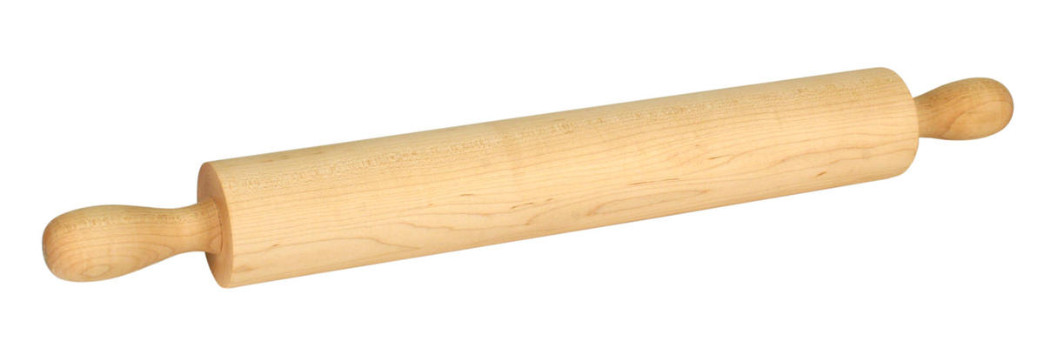
Let’s play a game

Slide 4
Here’s the rules:
Several teams are trying to make cookies
  Each team needs a certain set of kitchen items to make it happen
    Sets should be different
    Sets should not include entire kitchen
  Each team must collect all items needed before you can begin
  Teams cannot communicate
  If an item is not taken by another team, your team can take it
  Items cannot be stolen from another team
  Once all items are collected, your team “makes cookies” and then returns the kitchen items to the resource pool

Slide 5
Let’s play:
Try a few games and see what happens
Can you add a few rules to make sure the game works?
Describe necessary conditions for deadlock to occur – Coffman Conditions

